Slide 1
Creativity and Aesthetics Symposium
imagin
creat
Literary Landscapes
rt
mile
ive
Oana Moraru
Jennifer Boudewyn

Slide 2
What Inspires YOU?
“Imagination is the source of every form of human achievement. And it's the one thing that I believe we are systematically jeopardizing in the way we educate our children and ourselves.”
Sir Ken Robinson

Slide 3
What Inspires YOU?
“Creativity now is as important as literacy, and we should treat it with the same status.”
Sir Ken Robinson

Slide 4
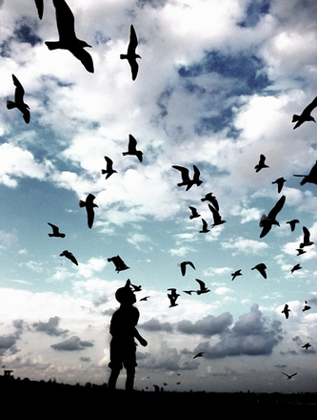
Inspire Yourself
Find inspiration from the world around you
Challenge yourself
Try something new
Greet obstacles with a smile
... This artist did!

Slide 5
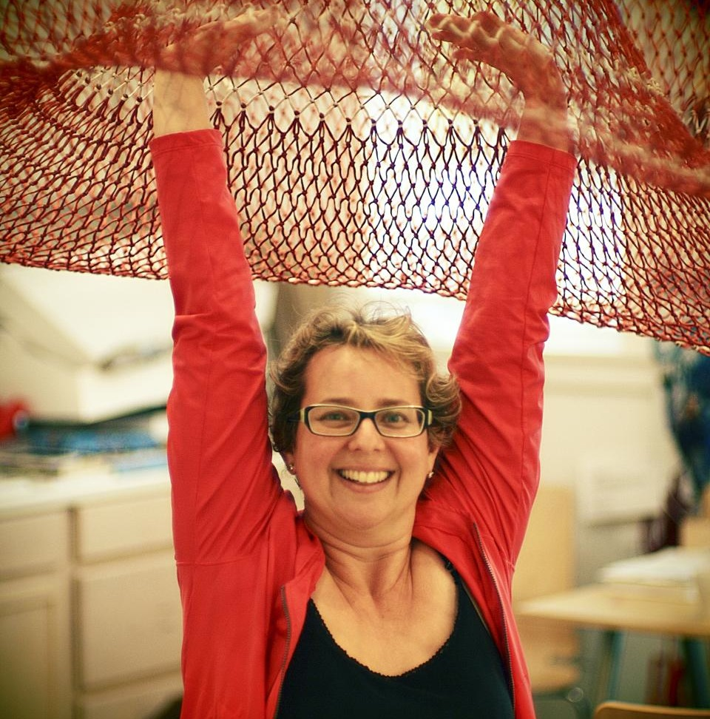
Janet Echelman
http://www.ted.com/talks/janet_echelman.html

Slide 6

You CREATE!
Pick a theme
Look for words that inspire and describe you
Choose your bristol board
Find words in magazines/newspapers
Write your own
Use letters and words in different fonts
You must include in your landscape:
Horizon line
Distinguishing element of nature
Focal point – foreground
Draw a basic landscape – cover the lines with words

Slide 7
Curriculum Connections!
Language:
Correct use of words and spelling
This could be done in any language!
Oral/written description and reflection of work
Science:
Elements of nature
Critical Thinking:
Students would have to explain why they chose certain words
Math:
Word groupings
Numbers
Number of times a word is used

Slide 8
What Inspires YOU?
“Education is what remains after one has forgotten what one has learned in school.”
Albert Einstein

Slide 9
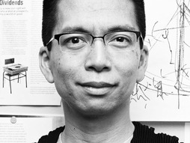
John Maeda
“How art, technology and design inform creative leaders”
http://www.ted.com/talks/john_maeda_how_art_technology_and_design_inform_creative_leaders.html

Slide 10
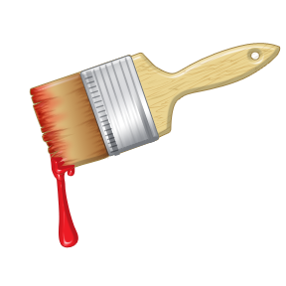
Take it Further!
Play with
Paint (watercolor/acrylic)
Markers
Coloured pencils
Now you can draw attention to, or even hide certain letters or words

Slide 11
Take Away
How could you apply this activity in your own teaching?
Are there areas within this project that you might change in order to accommodate your students’ needs?
*Note* that for younger grades you might have to provide students with the letters and words already cut up

Slide 12
HAVE FUN!
www.oana-moraru.com
www.jenniferboudewynart.ca
www.jennybcreative.blogspot.com

