Slide 1

CAE Symposium - Dance workshop
Oct 27, 2012
Kristin Danko, Emily Read, Heather Peace

Slide 2
Agenda
Introductions
Warm-up
Minds on
Dance as a concept
Dance in the curriculum
Action
Dance activities for the classroom
Cool down
Dance resources for educators
Cool down
Consolidation
Notes:
Name and gesture

Slide 3
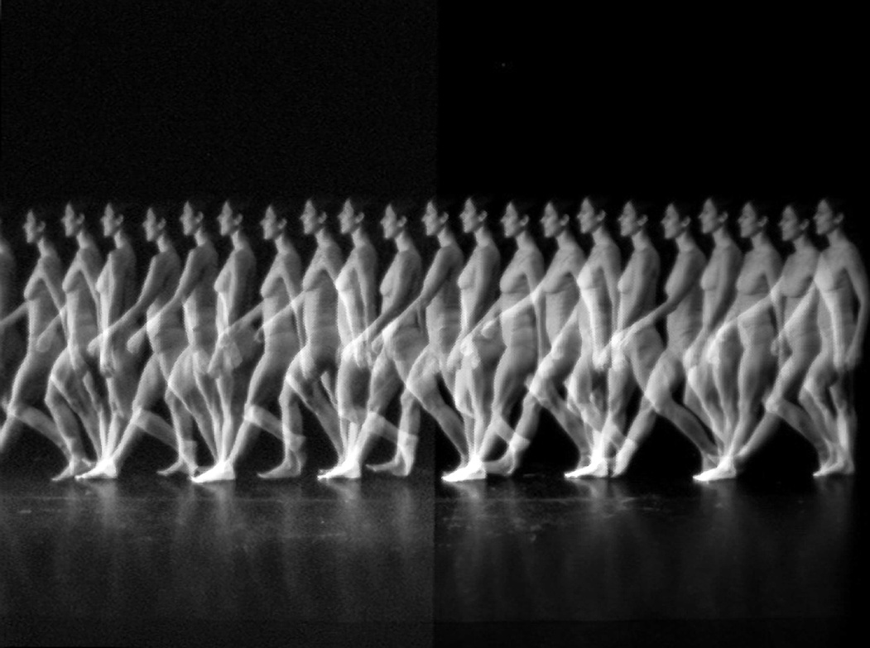
Warm-up
‘Line Move’
Ophea Creative Movement Lesson Plan (Grade 7, Lesson 1 of 5)
http://hpe.ophea.net/system/files/unit_document/2011/01/Gr7_MCAL_Mvt_Crtv_1of5_FINAL.pdf

Slide 4
Minds on
Dance as a concept…
What IS dance?

Slide 5
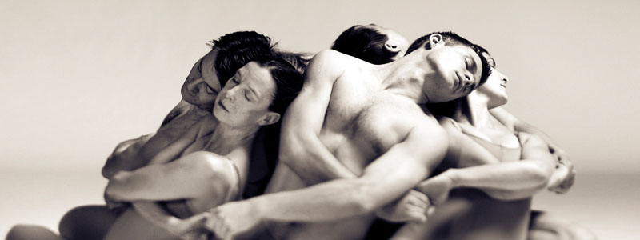
connection
beauty
art

Slide 6
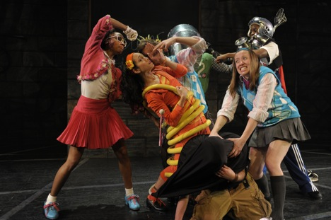
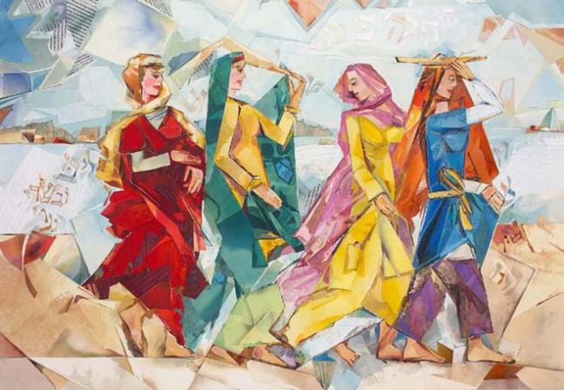
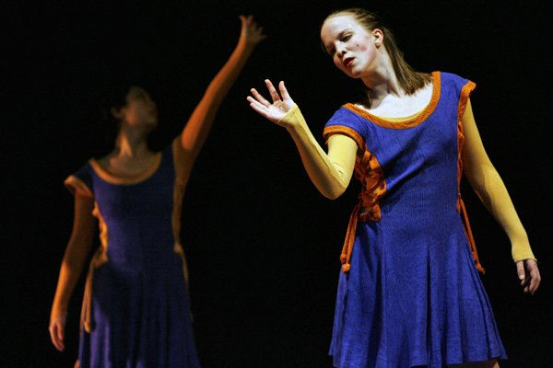
social justice
expression
history

Slide 7
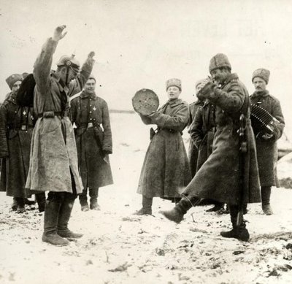
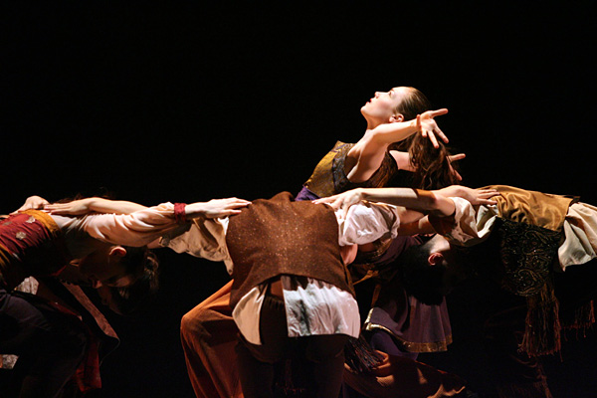
warmth
humanity
community
hope

Slide 8



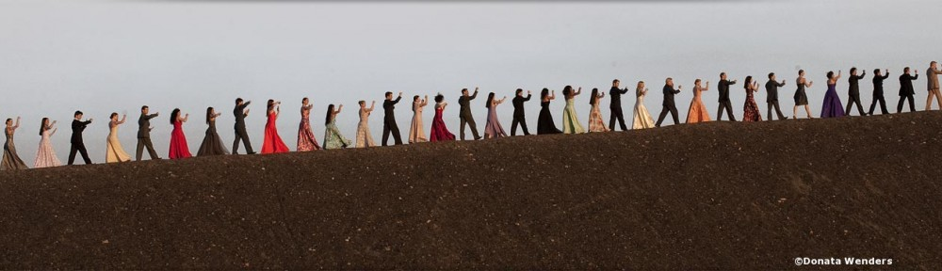
younger people
older people
continuity

Slide 9
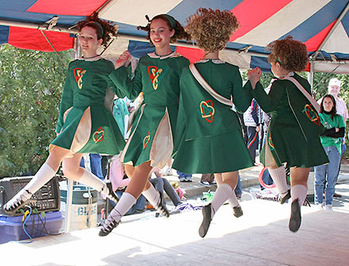
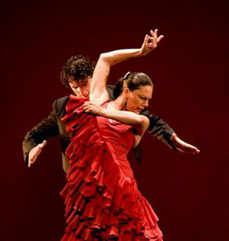
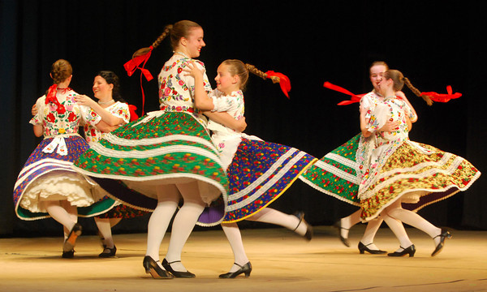
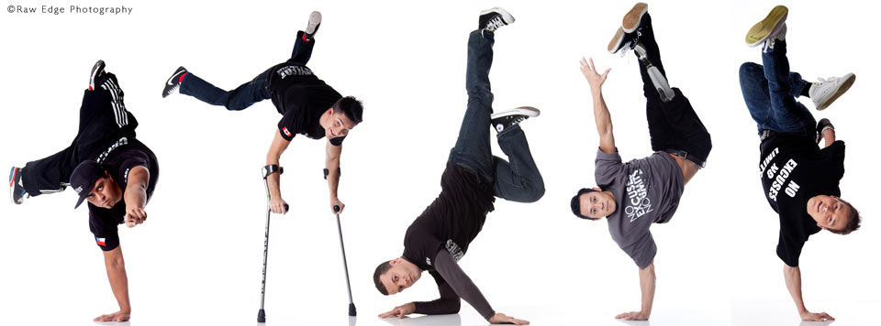
culture
identity

Slide 10
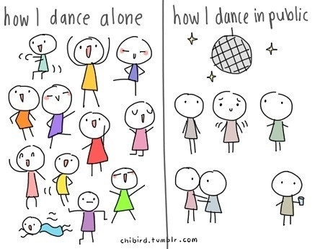
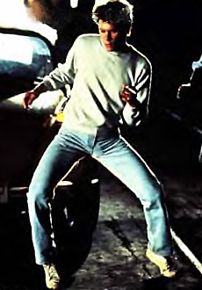
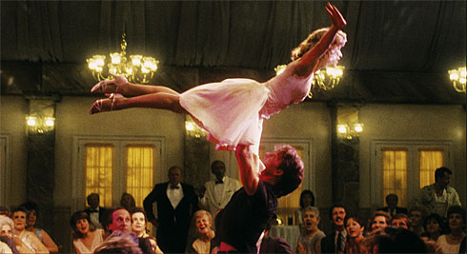
self knowledge
courage

Slide 11
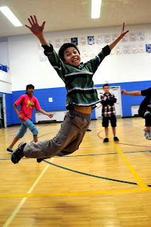
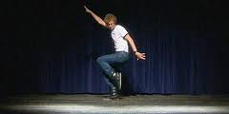
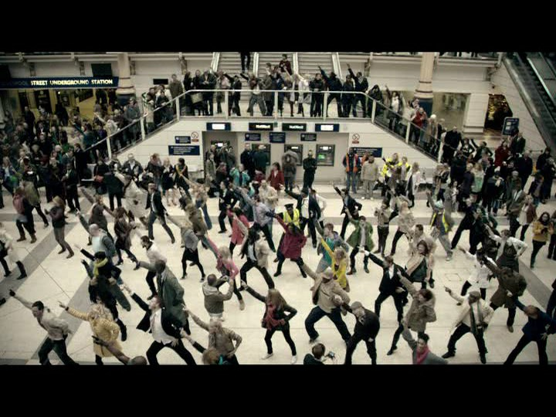

fun!
FUN!
FUN!
fun!
fun!
FUN!

Slide 12

Where the Hell is Matt?
Notes:
http://www.youtube.com/watch?v=Pwe-pA6TaZk

Slide 13

Ontario Curriculum
Dance is:
expressive movement with purpose and form
a physical and non-verbal medium for learning about the self and the world
Dance offers:
the opportunity to participate in learning in kinesthetic, cognitive, and imaginative ways
Notes:
Curriculum

Slide 14
Fundamental concepts of dance
Body, Space, Time, Energy, Relationship
With each grade, students extend and deepen understanding of these fundamental concepts
SAMPLE FUNDAMENTALS OF CONCEPTS FOR GRADE 4
BODY | SPACE | TIME | ENERGY | RELATIONSHIP
symmetry versus asymmetry, organic versus geometric shape, angular versus curved shape, gesture, body zones | positive versus negative space, pathways (e.g., in air, on floor) | tempo (e.g., increasing and decreasing speeds), rhythm (e.g., steady, irregular, erratic), pause, stillness, with music, without music, duration | effort, force, quality (e.g., punch, thrust, float, collapse, wiggle, explode, vibrate) | meet/part, follow/lead, groupings

Slide 15
Dance Overall Expectations
Creating and Presenting
Reflecting, Responding, and Analyzing
Exploring Forms and Cultural Contexts
Learning IN the arts
Learning ABOUT the arts
Learning THROUGH the arts

Slide 16
The good news for ‘non-dancer’ teachers…
Formal training not recommended (e.g., ballet, Graham, Limon techniques), especially at the elementary levels
Students encouraged to develop their own movement vocabularies, to create dance pieces that communicate their own feelings, ideas, and understandings

Slide 17
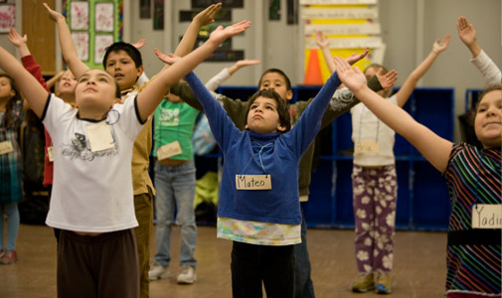
Dance activities in the classroom

Slide 18
Activity #1 – Bodies in Motion/Complimentary Freezes
‘Bodies in Motion’
Exploration of different ways of moving different body parts
Add varying levels, tempos, transitions, etc.
‘Complimentary Freeze’
Students move in different pathways
On teachers signal, students form complementary freeze positions with a partner
Ophea Creative Movement Lesson Plans (Grade 8, Lesson 5 of 5) http://hpe.ophea.net/system/files/unit_document/2011/01/Gr8_MCAL_Mvt_Crtv_5of5_FINAL.pdf; (Grade 8, Lesson 1 of 5) http://hpe.ophea.net/system/files/unit_document/2011/01/Gr8_MCAL_Mvt_Crtv_1of5_FINAL.pdf

Slide 19
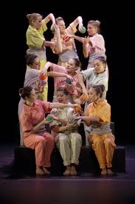
Activity #2 – Ball Passing
Choreographed sequences
Units of 3 students repeatedly pass bass to one another in dynamic, numerical and geometric ways
Charles Mouton (1989). Nine-person precision ball passing

Slide 20
Activity #3 – 3 Shape Dance
Goal is to create a movement sequence
Group explores and make a list of Shapes and Actions
Each dancer chooses:
3 actions that they like (one high, medium, and low)
2 transition movements (e.g. wiggle, swirl, roll)
Connect actions and transitions together (e.g., Shape¹ + Transition¹ + Shape² + Transition² + Shape³)
Dancers pair; teach each other sequences, and form one combined sequence
Rachel O’Brien (2012).

Slide 21

Cool down - Resources

Slide 22

OPHEA
AMAZING LESSON PLANS
Creative movement
Creative movement with equipment
Choreographed Dance
Extremely thorough and wonderful resources!!!

Slide 23

Elementary Teachers Federation of Ontario (ETFO)
Guide full of practical ideas and strategies to integrate the Ontario Arts curriculum (incl. dance) into the Junior classroom
Geared towards teachers with little or no teaching experience in the Arts
Includes assessment tips!

Slide 24

Council of Ontario Drama and Dance Educators
Network of Drama and Dance colleagues, artists, advocates, student teachers, etc.
Resource for drama and dance programs
Annual conference
http://code.on.ca/about-code

Slide 25

Arts Alive
TONS of stuff for Students, Teachers and Parents
For Teachers:
Virtual Dance Studio to create own works
Meet the artists online index of choreographers and dancers
Access to professional dancers for student mentoring/advice
Information on how to watch and discuss dance
Hours and hours of online video dance clips and artist interviews
Arts.Alive.ca

Slide 26

Pretty Big Dig
http://www.artsalive.ca/en/dan/mediatheque/videos/videosDetails.asp?mediaID=421

Slide 27

Momentum Moves Canada
Dedicated to encouraging participation in positive, creative and engaging activities
http://www.momentummovescanada.blogspot.ca/

Slide 28
10 Dance Related TED talks
The Legion of Extraordinary Dancers: In the Internet age, dance evolves
Ben Cameron: The true power of the performing arts
Kenichi Ebina’s magic moves
Mallika Sarabhai: Dance to change the world
Nalini Nadkarni on conserving the canopy
Mae Jemison on teaching arts and sciences together
Natasha Tasakos’ multimedia theatrical adventure
Ananda Shankar Jayant fights cancer with dance
Pilobolus Performs “Symbiosis”
Ken Robinson says schools kill creativity
http://socialrhythms.wordpress.com/2011/06/14/ted-talks/
Notes:
http://socialrhythms.wordpress.com/2011/06/14/ted-talks/

Slide 29
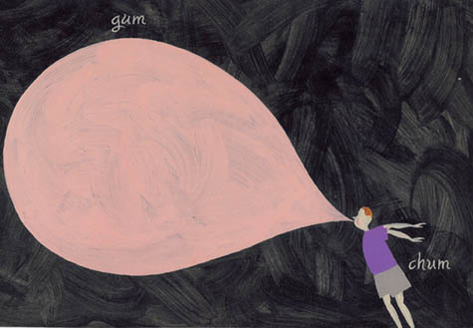
Cool down - ‘Bubble gum game’

Slide 30
Consolidations
What can dance teach students?
Infinite cross-curricular linkages
Built-in DPA
Fun factor disguises the work of both learning and physical activity
Fosters self esteem, courage (in self); empathy, acceptance (in others)
Mind-body connection
Thoughts/comments/questions?

Slide 31

Thank you for your participation!

